Slide 1

Bulletin Board
You get what you ask

Slide 2

Are you new to Town
What to Buy. Where to Go. Oh no!!!!!

Slide 3
Features Of Bulletin Board!
Ask question to nearby locals.
Look for particular category for specific topics
Send an Email to any colleague or any local
Chat box to get some quick help
Search and add questions
Are you familiarize?? Great!! Now help others with answering questions to newbie by adding answer feature.
Option to login with Facebook or Email

Slide 4
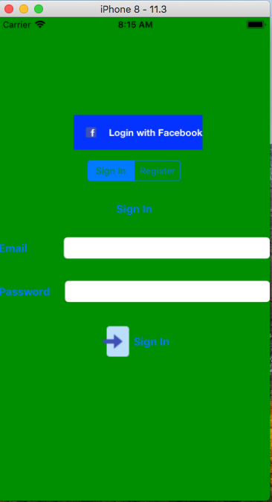

Steps:

Slide 5
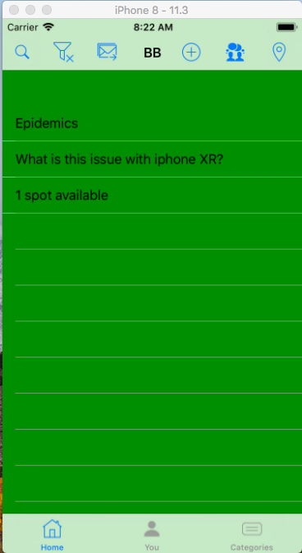
Home Screen

Slide 6
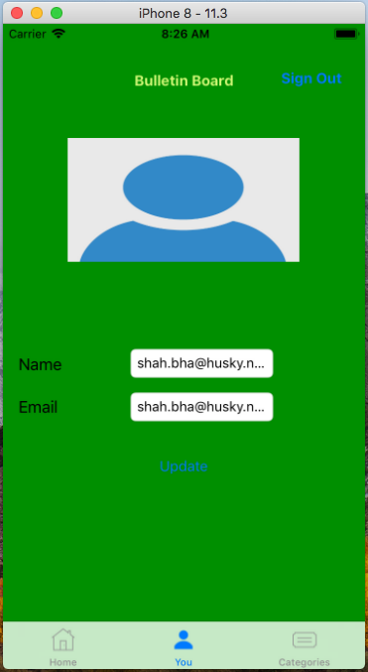
Update Profile

Slide 7
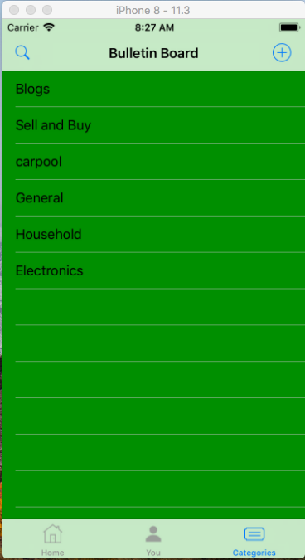
Category

Slide 8
What is used?
Bulletin board is created in swift 4 and xcode 10.
App has a support of Firebase as backend.

Slide 9
Conclusion: This is just the beginning
App is created at a very root level supporting core functionality.
V2.0 will have some features such as:
Gmail Login
Bookmark category
Payment Gateway
And many more…

Slide 10
Thank You

